Slide 1
WHAT MOTIVATES TEACHERS? TAMF ATC1 – Mexico City 8 March 2019
Dave Allan
President, NILE

Slide 2
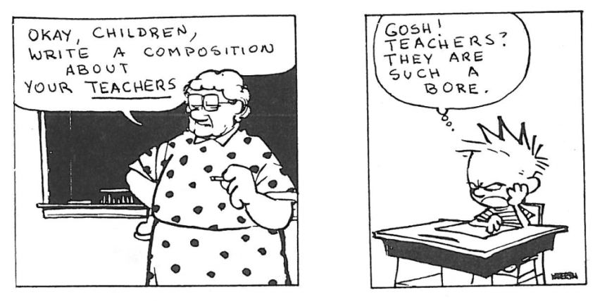
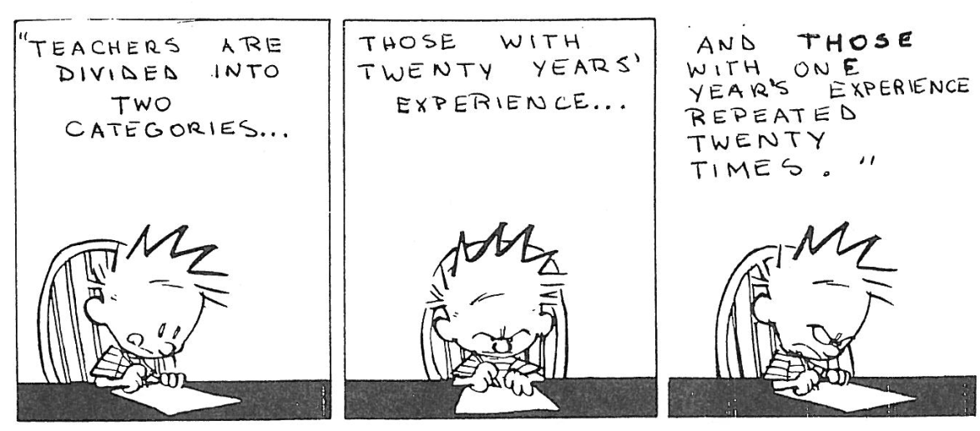

Slide 3
What motivates teachers?
Some interesting observations from the literature on motivation in education:
‘Perhaps surprisingly it’s not the money, or at least not the money beyond a certain point’ (Rigby, R. 2012)
‘Low salary will act as a strong demotivator..... but (above the going rate) ..... the motivational effect of extra pay will be fairly small’ (Daniel Pink, 2010)

Slide 4
What motivates teachers?
‘Everybody’s different and they’re motivated by different things’(Arnold, C. 2012)
Depending on who you are, when it is in your life, working life & relationships, job security and salary stability can be strong extrinsic motivation
Among women integrative motivation is far stronger than in men

Slide 5
Good leaders inspire others……..
they understand what motivates their team because they genuinely take the time to find out about individuals and let their team get on with their jobs
(many teachers do have a lot of autonomy, but what is the impact of classroom doors always being closed?)
they offer direction, provide a sense of purpose and of values, give a ‘road map’, are on hand to offer help, but don’t always micromanage and get in the way.
‘Recognition is a great motivator. People want to be held in high esteem and valued for a job well done.’

Slide 6
What motivates teachers?
Most studies have found that teachers are motivated more by intrinsic than extrinsic rewards:
‘Most teachers perceive their needs and measure their job satisfaction by factors such as participation in decision-making, use of valued skills, freedom and independence, challenge, expression of creativity and opportunities for continued learning’

Slide 7
What motivates teachers?
‘High internal motivation, work satisfaction and high-quality performance depend on three critical psychological states: experienced meaningfulness, responsibility for outcomes and knowledge of results.’
These are typical of what applies to ‘the professions’ …………. but

Slide 8
as we know from the likes of Herzberg, Maslow, Deci and more recently Hackman, Pennington, Coyle and others such as Pink (2011) and Roddy (2011)
It’s hard to maintain intrinsic motivation and a sense of vocation when you’re struggling to make a living – if the ‘hygiene factors’, the basic needs of life, are not being adequately met then it’s hard to be a motivated professional. Doctors and lawyers are often (not always) well paid – teachers very rarely are.
https://www.youtube.com/watch?v=kSDPhhfEY5A

Slide 9
What motivates teachers?
Teachers are often greatly appreciated but not often well paid, so autonomy, purpose and mastery are sometimes in conflict with compliance, job security and paying the bills.
In the absence of cash, those responsible for managing teachers and for motivating them have to ask what other kinds of currency may be available.

Slide 10
A very brief summary of much of the literature on teacher motivation:
Teaching is a multi-skilled job and cannot respond to a factory-type motivational model. Effective teachers are flexible, imaginative, innovative, empathetic and often passionate, so motivating teachers must include clarifying their purposes and allowing them autonomy.

Slide 11
What do English language teachers around the world often say about what motivates them?
Being respected as a teacher
Not being too overloaded
Getting energy back from students’ interest and enthusiasm
Being flexible and open to new things

Slide 12
What motivates English language teachers?
Being allowed to do what I do best, which is teach
Finding ways to rekindle the spark that made you love doing it in the first place – different ways to carry on learning
Reflecting on what lots of other jobs would be like
Remembering that everyone remembers a good teacher

Slide 13
The key factors in English language teacher motivation from all round the world
Intrinsic motivation & the things that make it last:
Long-term love of language
Love of people
Passion for teaching
The spark of the new
Collaboration with colleagues

Slide 14
The key factors in English language teacher motivation from all round the world
Respect/self-respect
Pleasure of working with pupils
Esteem/self-esteem
Professional autonomy
Boss of own world
Chances for innovation, creativity
Regular feedback
Participation in decision-making

Slide 15
The key factors in English language teacher motivation from all round the world
Being listened to and having views considered
Having the chance for regular, relevant CPD
Getting better at it, especially things that had been difficult or a source of problems
Being able to inspire learners
Learning from learners
Working with other motivated teachers
Natural personal enthusiasm

